Slide 1
LNHS PTSA Tuesday, September 20, 2022 6:30pm General Meeting
Followed By
MEET THE ATHLETIC DIRECTORS
Q&A with Chelsea John & Joel Adkins

Slide 2
LNHS PTSA Meeting Agenda September 20, 2022
Agenda:
Welcome/Confirm Quorum/FB Live Attendees
Meeting Called to Order by President
Introductions/Special Guests
Position Board Members
President Christal Feldman
1st VP - Membership Brenda Meadows
Treasurer Michelle Adamick
Recording Secretary Gabriella Nguyen
Corresponding Secretary Sophia Rogers
Chairs
LWL Advisors Suzanne Arnold & Tania Abreu
Finance Chair Gita Raghoonandan
Staff Appreciation Angie Garcia & Iris Metel
Web Master Erika Remley
Staff Liaison Kari Grimm
OLD BUSINESS
Approval of Past Minutes (August)
Review of July and August Financial Reports
NEW BUSINESS
Vote on Proposed REVISED 2022-2023 Budget
Membership Updates
Spirit Wear Sales
Legacy Brick Campaign
Amazon Smile
Staff Appreciation
Learn with Lions
Communication Updates/Announcements
Next Meeting - Tuesday, October 18th at 6:30pm
Meeting Adjourned by President
September Meeting Topic: MEET THE ATHLETIC DIRECTORS - Q&A

Slide 3
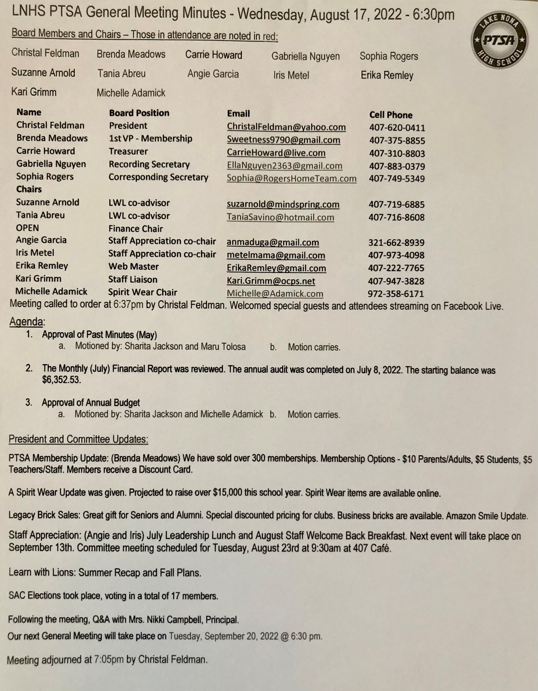
PAST MINUTES FOR APPROVAL August 17, 2022

Slide 4
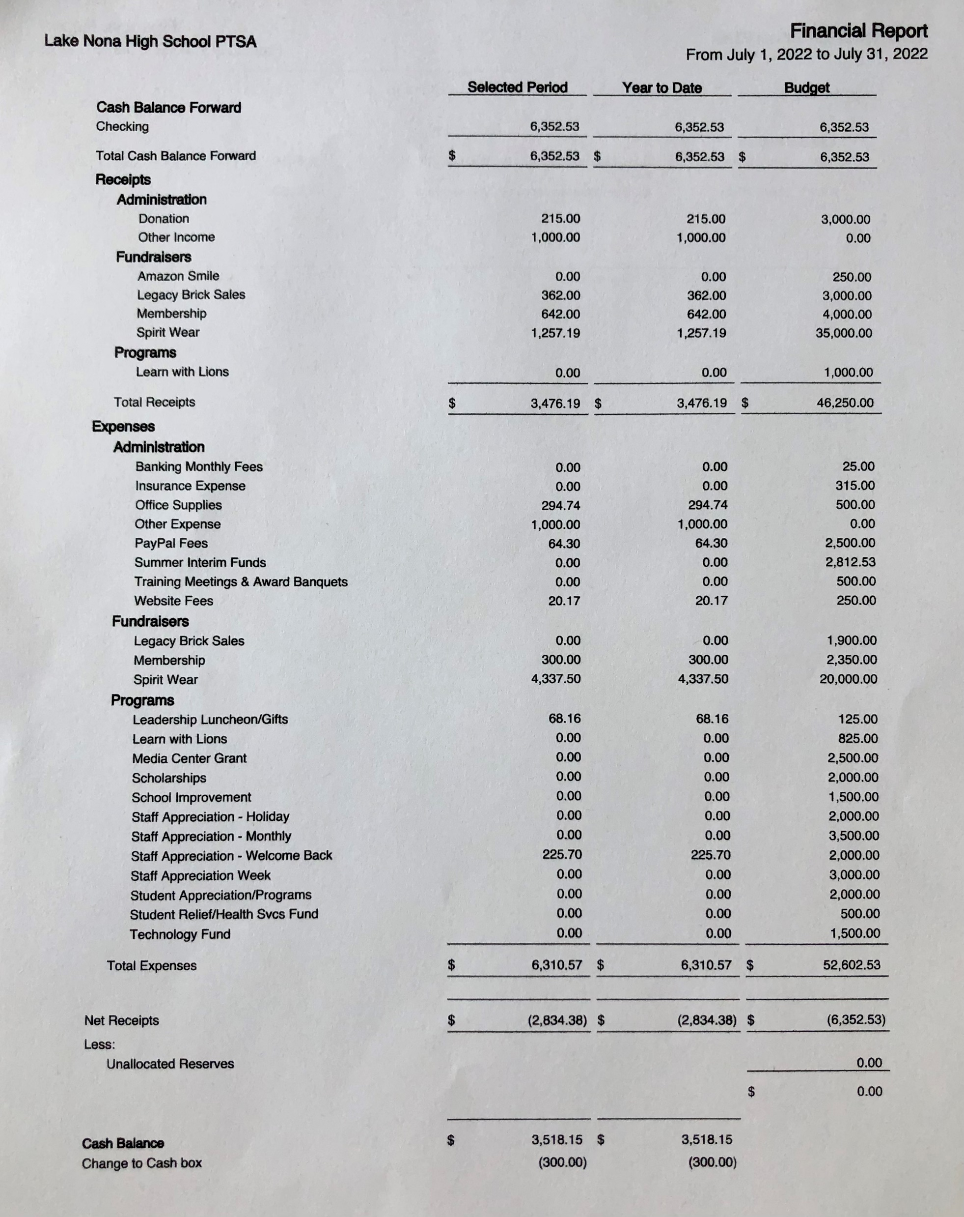
FINANCIAL REPORT FOR APPROVAL July 2022 Financial Report
Year to Date Summary July Beginning Balance - $6,352.53
July Ending Balance - $3,218.15

Slide 5
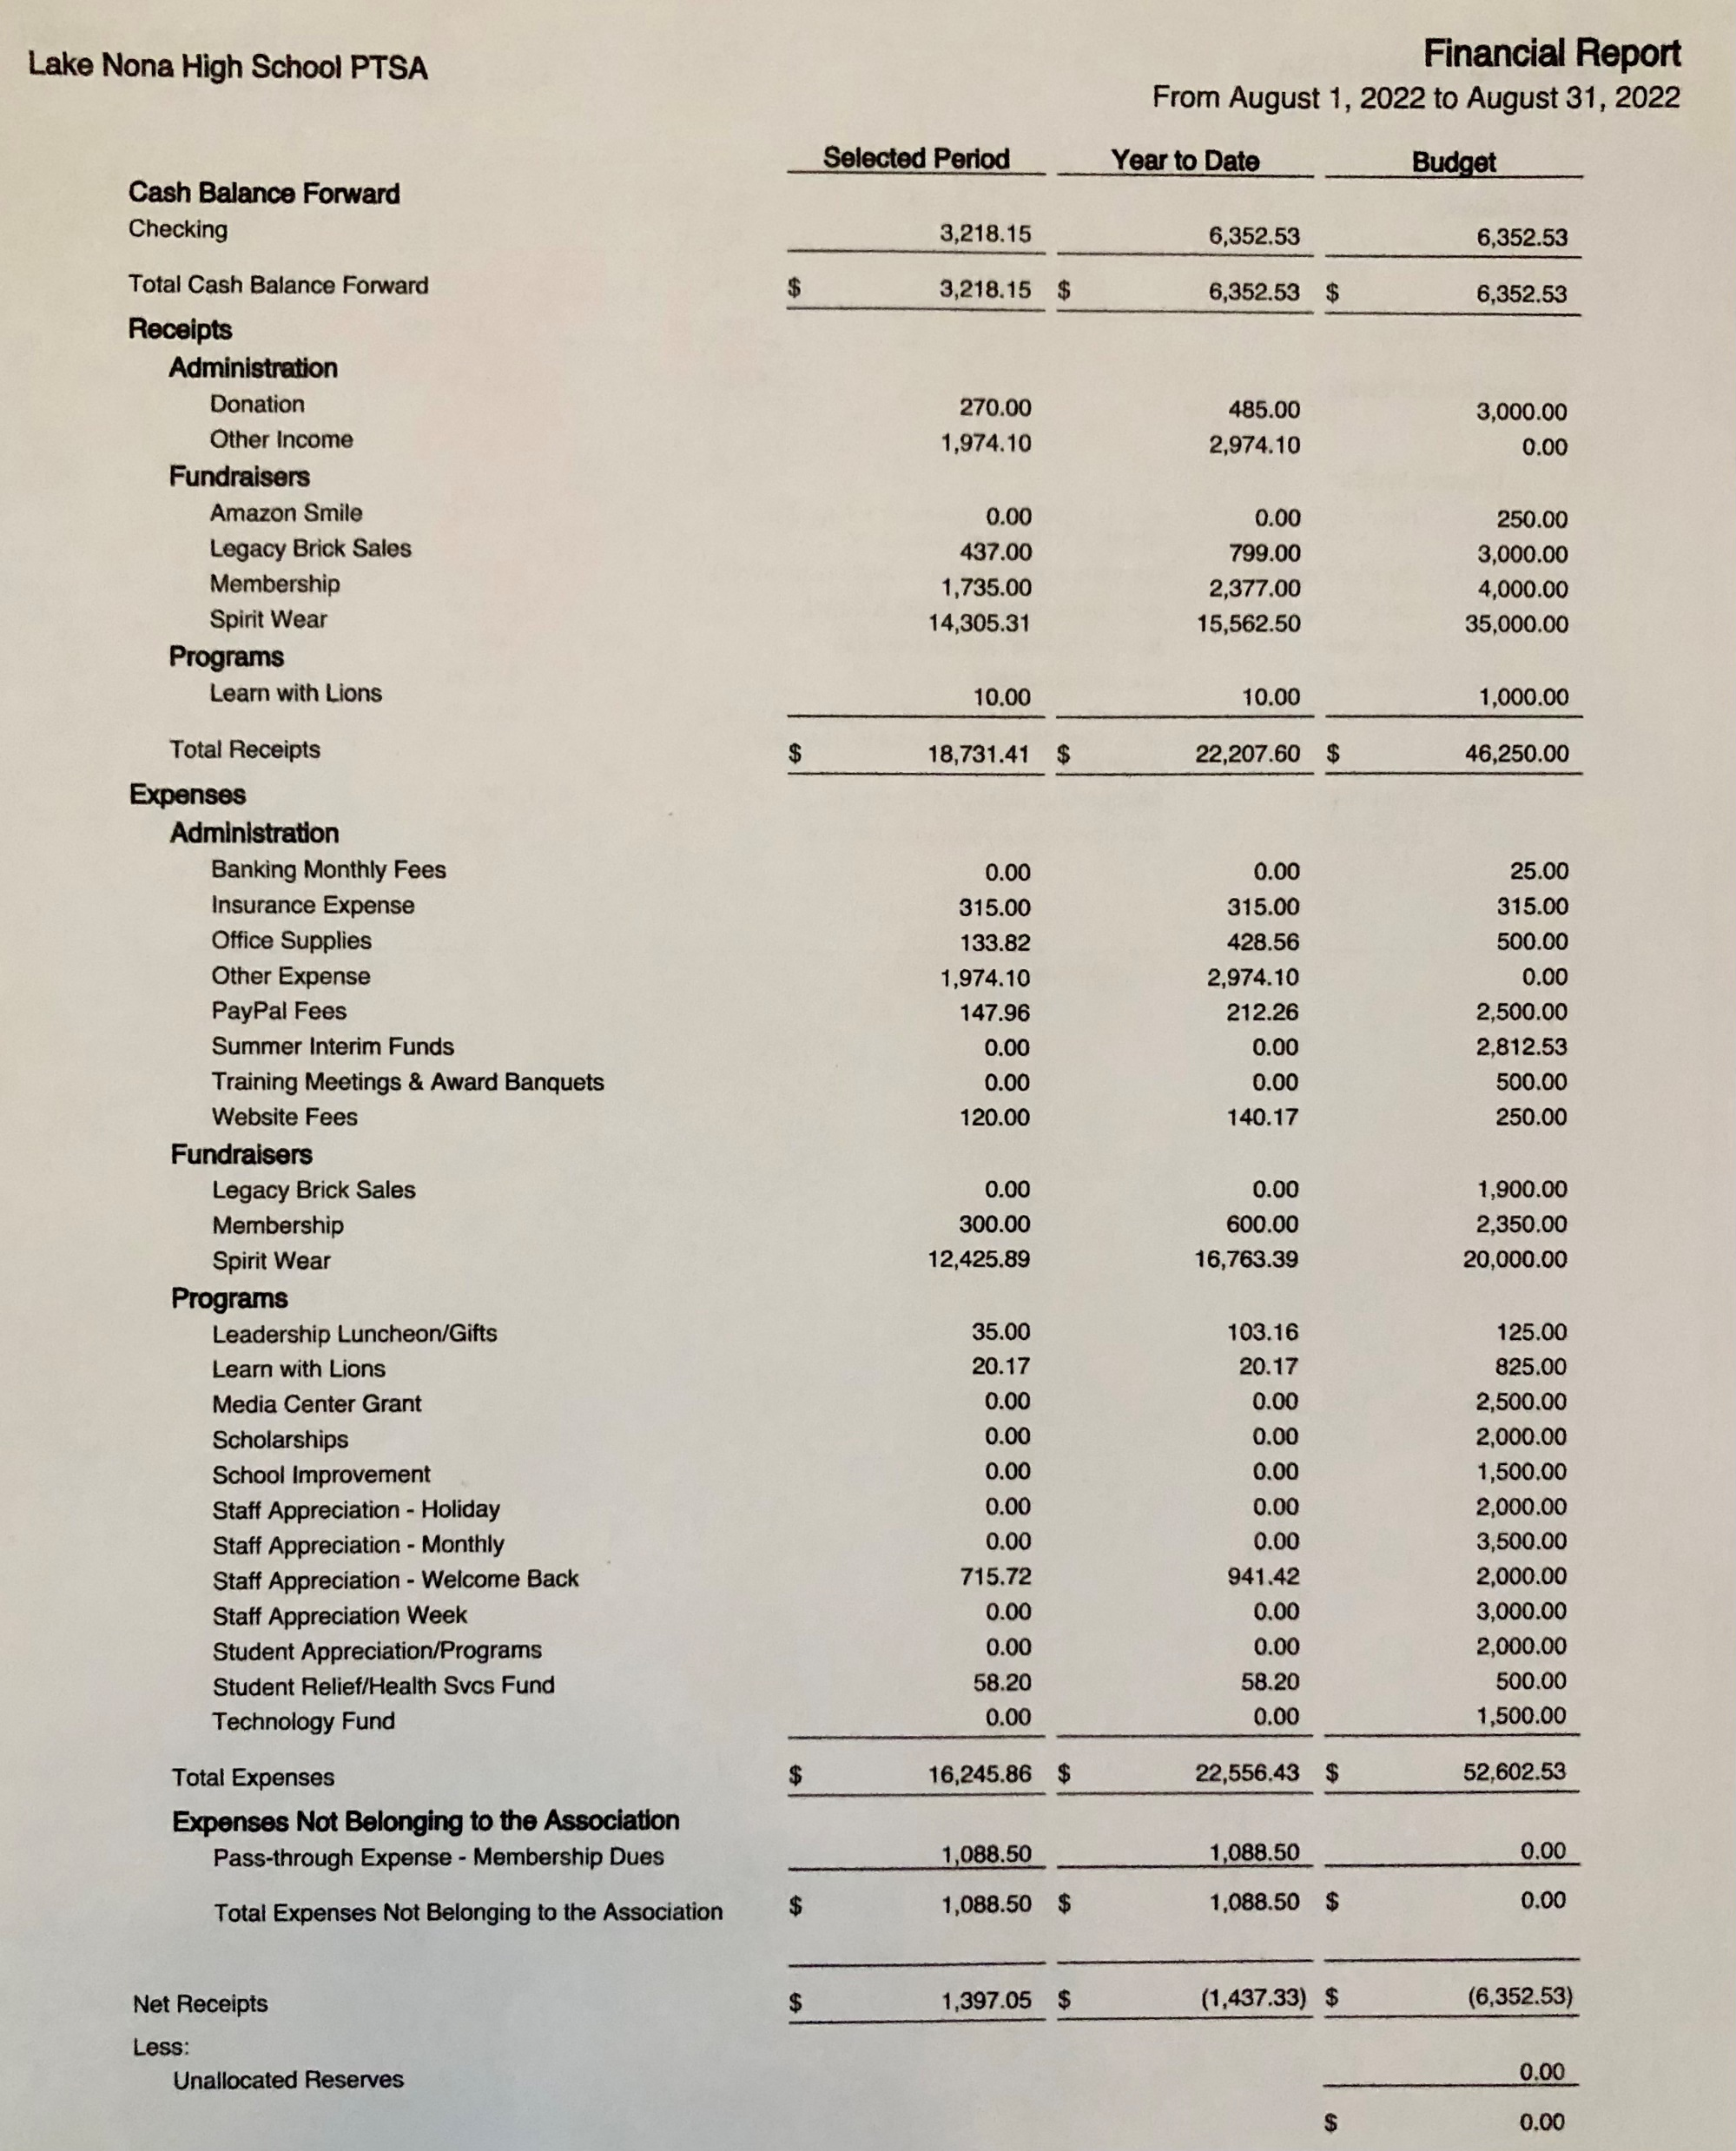
FINANCIAL REPORT FOR APPROVAL August 2022 Financial Report
Year to Date Summary August Beginning Balance - $3,218.15
August Ending Balance - $4,254.20

Slide 6
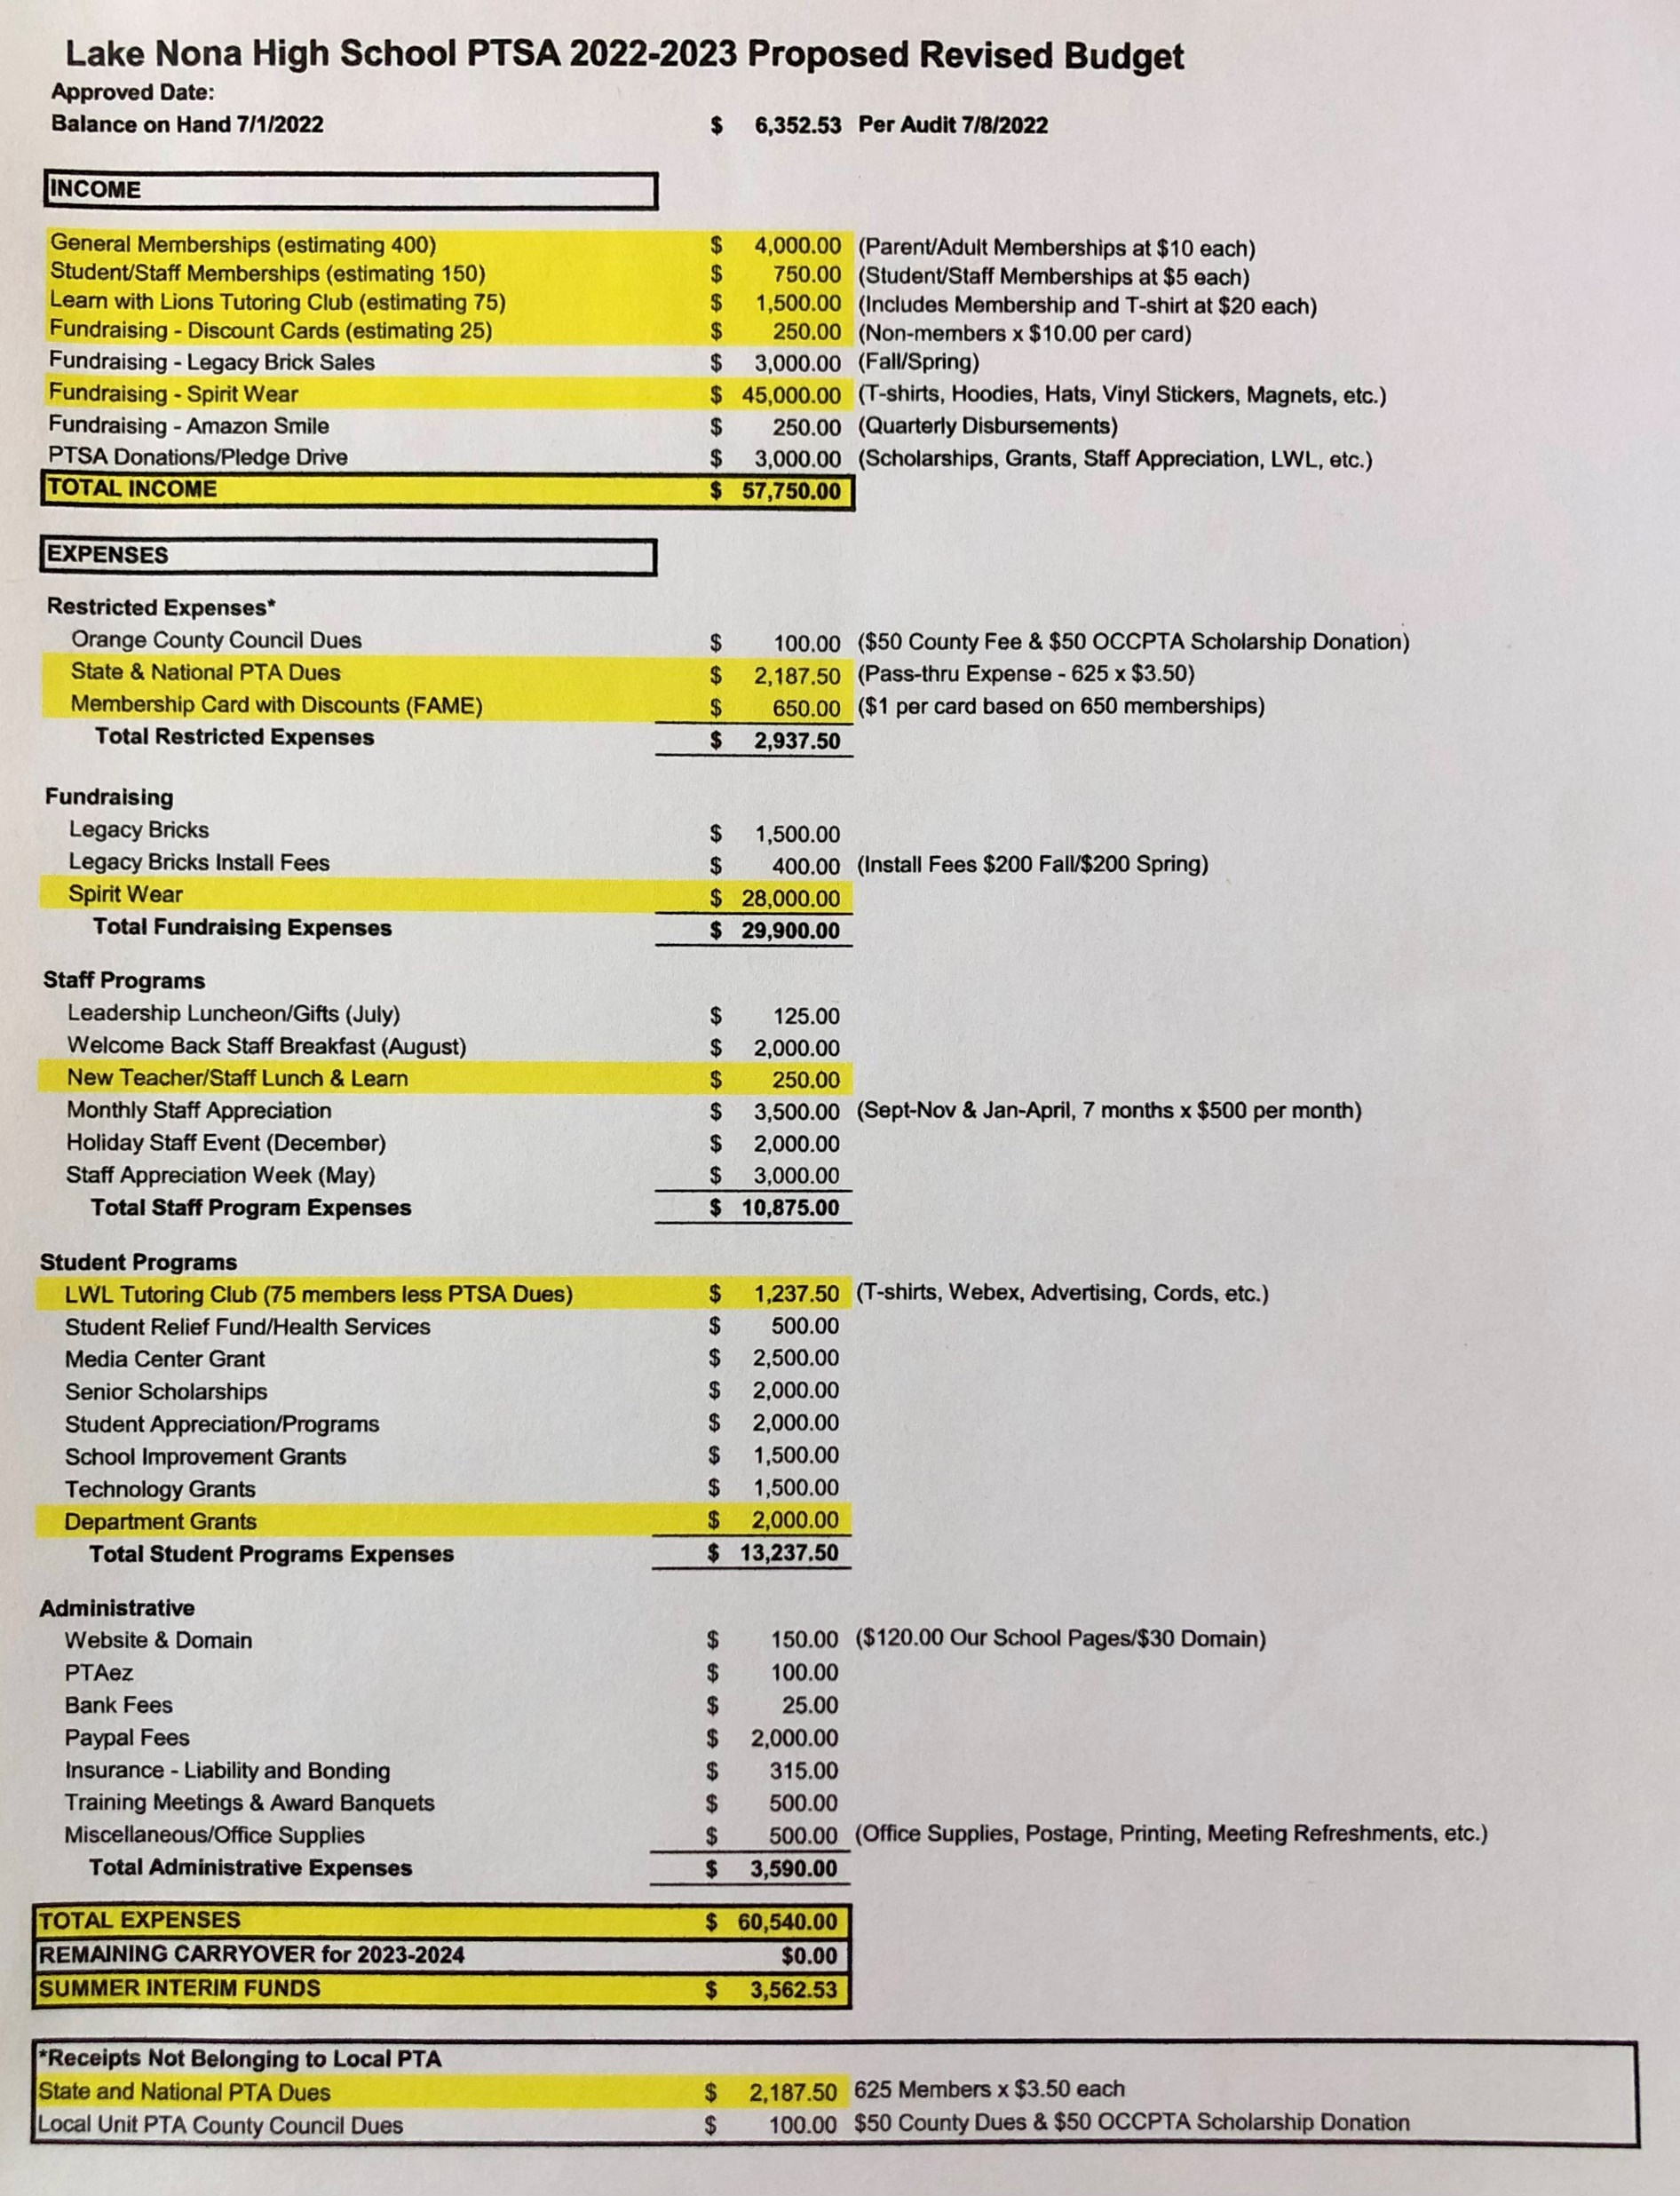
2022-2023
LNHS PTSA
PROPOSED
REVISED BUDGET
FOR APPROVAL Annual Budget July 2022 - June 2023 Summary Beginning Balance - $6,352.53
Projected Income - $57,750.00
Projected Expenses - $60,540.00
Summer Interim Funds - $3,562.53

Slide 7
PTSA MEMBERSHIP - Currently Over 500 Memberships Received - Our Goal is 650 Memberships Membership Options Parent/Adult - $10 Teachers & Staff - $5 Students - $5 (Includes Discount Card)

Slide 8
SPIRIT WEAR - New Designs & More Sizes (Youth up to Adult 4XL) - Added Hats, Visors and Dry Fit Shirts - Stay Tuned for More Options (Sweatpants, Tank Tops, Polos and Windbreakers) - Spirit Store On Campus (Open Thursdays before Away Football Games and Thurs/Fri before Home Football Games) - Selling at Athletic Games - Projected to Raise OVER $15,000

Slide 9
LEGACY
BRICK SALES - Great Gift for Seniors & Alumni
- Special Pricing for Clubs
- Business Bricks Available

Slide 10
Add Lake Nona High School
to Your Amazon Account
while shopping ONLINE!
www.smile.amazon.com

Slide 11
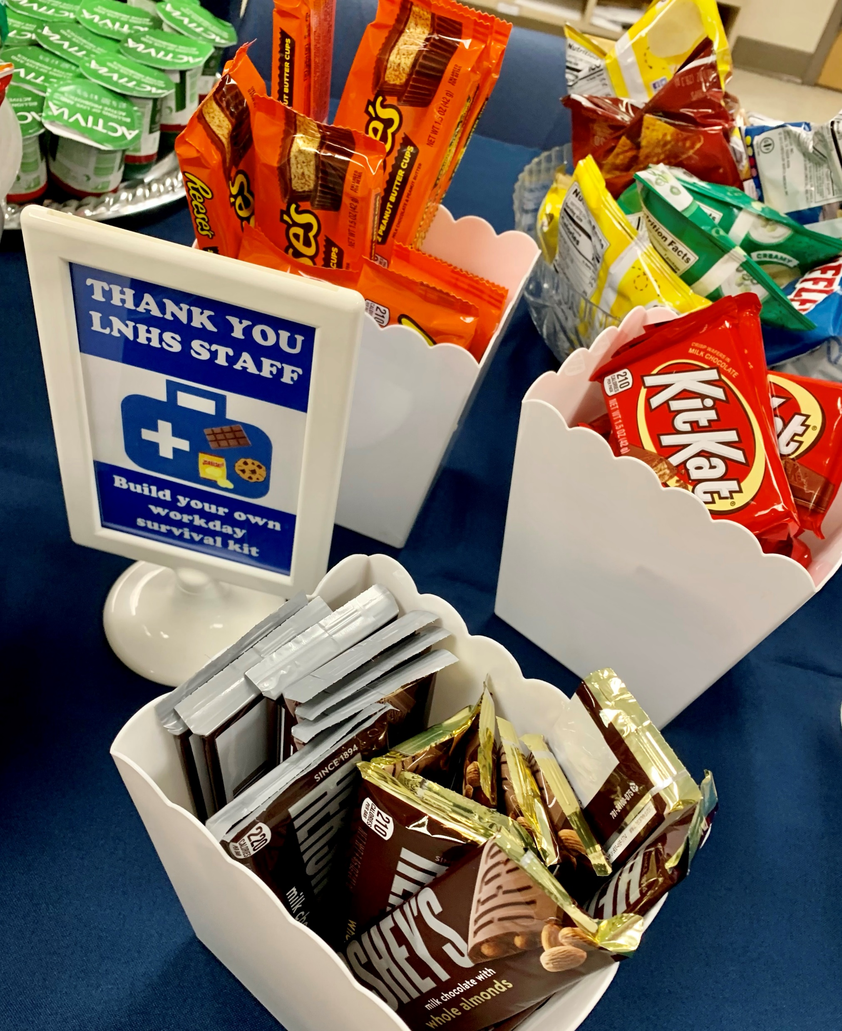
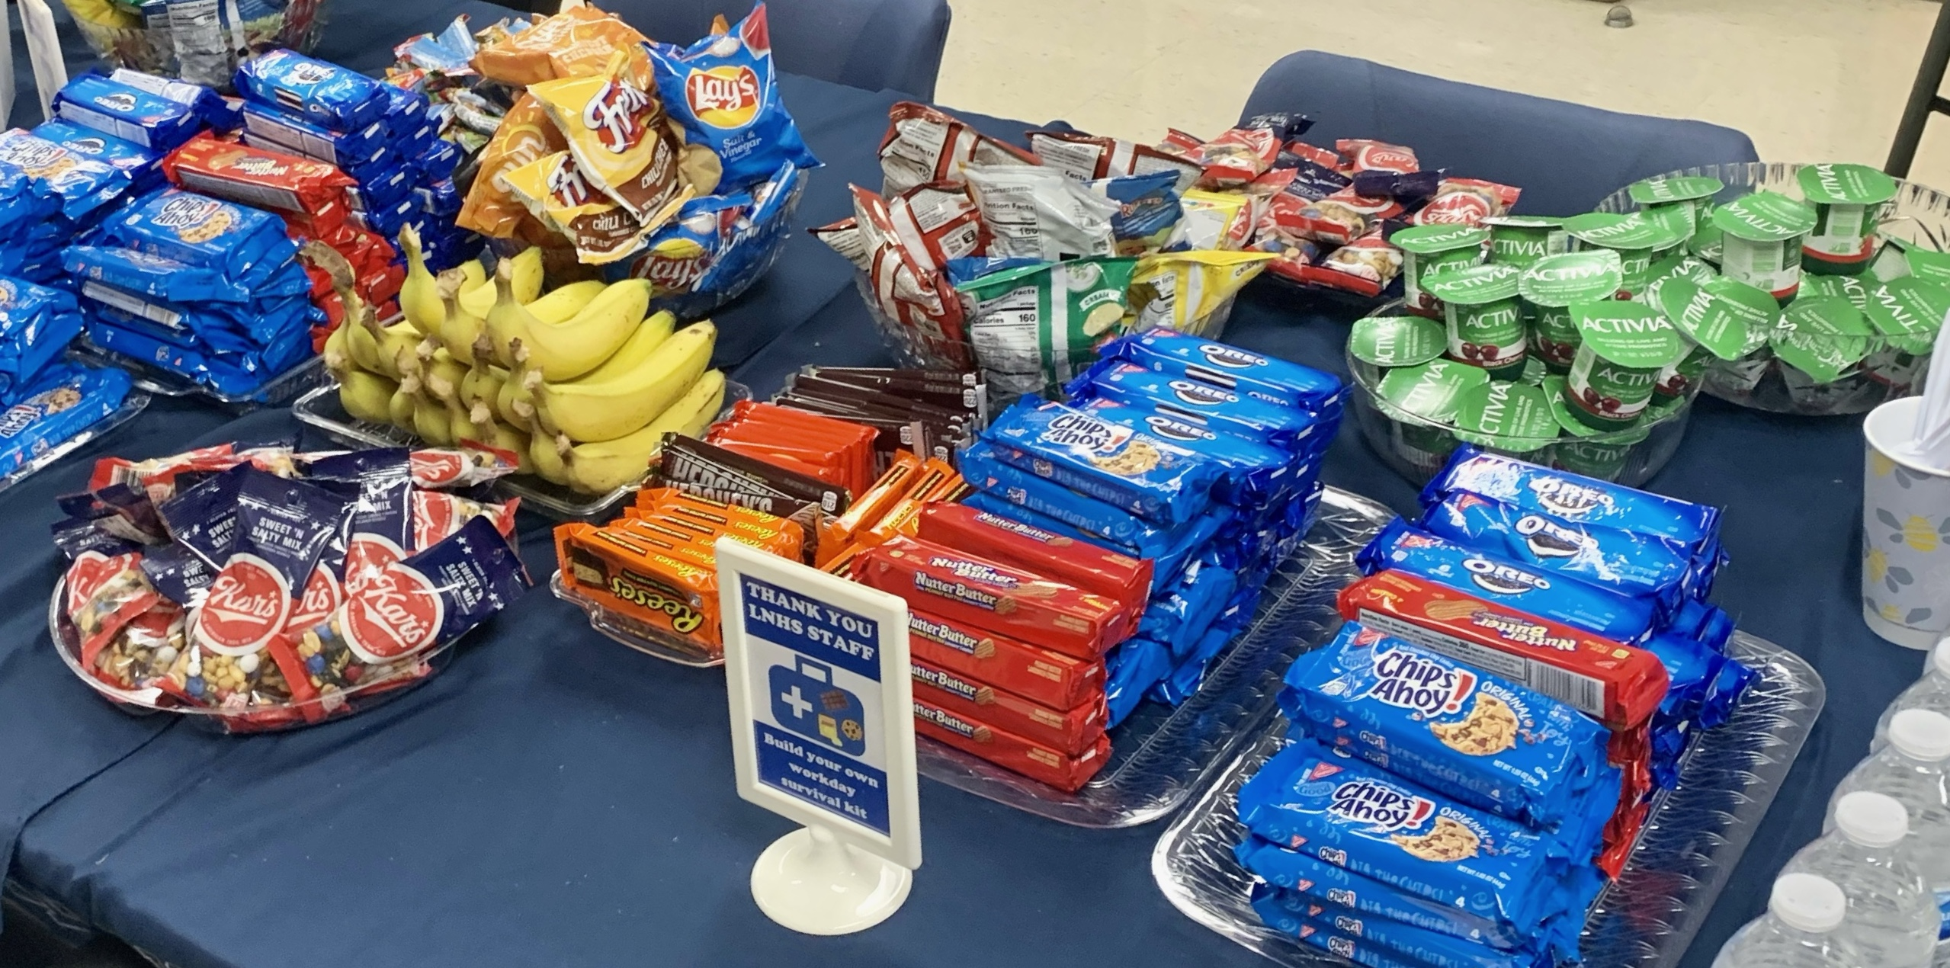
AUGUST
BACK TO SCHOOL
SURVIVAL KIT
STAFF
APPRECIATION
Monthly Events, Mailbox Treats, Holiday Celebration and
Staff Appreciation Week
Next Staff Appreciation Event
October - Date TBD
THANK YOU TO OUR VOLUNTEERS!

Slide 12
Learn With Lions Free Private Virtual Tutoring
Our PTSA LWL Club has top performing high school students tutor elementary and middle school students that need help in reading, math, science or social studies.
These 40–50-minute sessions are 1-2 times per week, at times that work for you.
Parent/Student Registration is now open. Spaces are Limited. Fall sessions run through Nov. 18th.
Tutors earn Community Service Hours towards Bright Future Scholarship requirements.
Tutor one-on-one with Zoom or WebEx from home. (No meetings at school.)
Tutors select their students according to subject, grade, and schedule. (Earn 1-4 hours per week)
Gain experience as teachers, mentors & role models.
Only club to allow Fall or Spring, or both, & Summer.
Our student board of Sophomores & Juniors serves from Jan – Dec, so our experienced board members can help incoming board members in January.
Tutor/Club Fall 2022 Applications
September 19th – October 9th
www.LearnWithLions.com
Requirements:
3.25 Unweighted GPA
Freshmen can apply in January
Personal computer (Non OCPS computer)
*exception requests can be sent
from a Non-OCPS email to:
Advisor-LWL@LNHSPTSA.com
Sponsored by LNHS PTSA & Lake Nona Regional Chamber of Commerce Preguntas? Perguntas? Advisor1-LWL@LNHSPTSA.com

Slide 13
PTSA STAFF APPRECIATION

Slide 14
STAY CONNECTED
WITH LNHS PTSA
PTSA STAFF APPRECIATION
www.LNHSPTSA.com
www.Facebook.com/LNHSPTSA
SAVE THE DATE
Next General Meeting
Tuesday, October 18, 2022 at 6:30pm

Slide 15
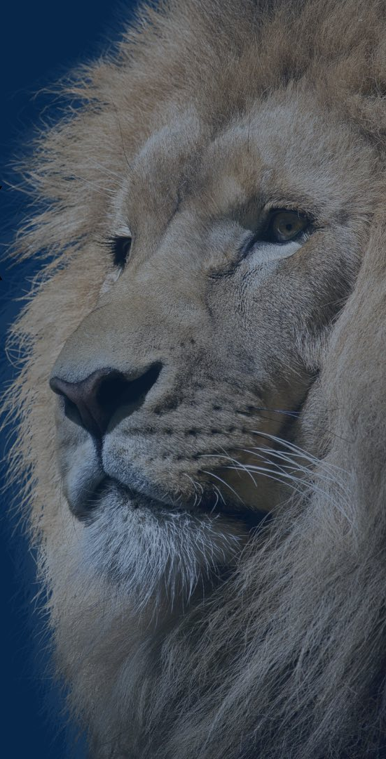
LNHS PTSA September Meeting Topic
MEET THE
ATHLETIC DIRECTORS
Q&A Session
Chelsea John & Joel Adkins
Chelsea.John@ocps.net
Joel.Adkins@ocps.net
www.LakeNonaAthletics.org

